Slide 1
AI based Liver Cancer Detection
Using Residual Network Architecture
PROJECT GUIDE PROJECT MEMBERS
Dr .N. Muthukumaran Priyadharshini (95071914073)
Vijaya Shree K (95071914100)
Vinisha . P (95071914101)

Slide 2
AREA OF THE PROJECT:
Digital Image Processing
FIELD OF THE PROJECT:
Bio Medical Image Processing
Liver Cancer Detection
Deep Learning

Slide 3
Literature Survey 1
Title | Author | Year | Description |  | Demerits
Interpretable Machine Learning for Characterization of Focal Liver Lesions by Contrast-Enhanced Ultrasound | Simona Turco , Member, IEEE, Thodsawit Tiyarattanachai , Kambez Ebrahimkheil , John Eisenbrey , Aya Kamaya, Massimo Mischi , Senior Member, IEEE, Andrej Lyshchik, and Ahmed El Kaffas , Member, IEEE | VOLUME: 69, JAN. 2022 | This work proposes an interpretable radiomics approach to differentiate between malignant and benign focal liver lesions (FLLs) on contrast-enhanced ultrasound (CEUS). Although CEUS has shown promise for differential FLLs diagnosis, current clinical assessment is performed only by qualitative analysis of the contrast enhancement patterns. |  | only 78% accuracy
Literature Survey 2
Title | Author | Year | Description |  | Demerits
Deep Learning-Based Classification of Liver Cancer Histopathology Images Using Only Global Labels | Chunli Sun, Ao Xu, Dong Liu, Zhiwei Xiong, Feng Zhao* and Weiping Ding* | VOLUME: 18, JAN. 2019 | This paper proposes a deep learning method for liver cancer histopathological image classification using only global labels. To compensate for the lack of detailed cancer region annotations in those images, patch features are extracted and fully utilized. |  | less stable

Slide 4
Literature Survey 3
Title | Author | Year | Description |  | Demerits
Neural networks for deep radiotherapy dose analysis and prediction of liver SBRT outcomes | Bulat Ibragimov, Diego A.S. Toesca, Yixuan Yuan, Albert C. Koong, Daniel T. Chang and Lei Xing | VOLUME: 8, JAN. 2018 | They developed a multi-path neural network with the convolutional path for 3D dose plan analysis and fully-connected path for other variables analysis, where the network was trained to predict postSBRT survival and local cancer progression. . |  | less accurate
Literature Survey 4
Title | Author | Year | Description |  | Demerits
A Fast and Furious Bayesian Network and Its Application of Identifying Colon Cancer to Liver Metastasis Gene Regulatory Networks | Enze Liu, Jin Li, Garrett H. Kinnebrew, Pengyue Zhang, Yan Zhang, Lijun Cheng and Lang Li | VOLUME: 8, JAN. 2019 | They proposed a novel search algorithm - Fast and Furious Bayesian Network (FFBN). |  | Complex architecture

Slide 5
Literature Survey 5
Title | Author | Year | Description |  | Demerits
Liver Cancer Detection Using Hybridized Fully Convolutional Neural Network Based on Deep Learning Framework | XIN DONG 1 , YIZHAO ZHOU 1 , LANTIAN WANG 1 , JINGFENG PENG 2 , YANBO LOU 2 , AND YIQUN FAN 2 | VOLUME: 8, JAN. 2020 | In this paper, the Hybridized Fully Convolutional Neural Network (HFCNN) has been proposed for liver tumor segmentation, which has been modeled mathematically to resolve the current issue of liver cancer. |  | Less stability
Literature Survey 6
Title | Author | Year | Description |  | Demerits
Multi-Source Transfer Learning via Multi-Kernel Support Vector Machine Plus for B-Mode Ultrasound-Based Computer-Aided Diagnosis of Liver Cancers | Huili Zhang, Lehang Guo, Dan Wang, Jun Wang, Member, IEEE, Lili Bao, Shihui Ying, Member, IEEE, Huixiong Xu, Jun Shi Member, IEEE | VOLUME: 12, JAN. 2021 | In this work, they propose to improve the BUS-based computer aided diagnosis for liver cancers by transferring knowledge from the multi-view CEUS images, including the arterial phase, portal venous phase, and delayed phase, respectively. . |  | Less accurate

Slide 6
Literature Survey 7
Title | Author | Year | Description |  | Demerits
Effective Natural Language Processing and Interpretable Machine Learning for Structuring CT Liver-Tumor Reports | YI-HSUAN CHUANG1 , JA-HWUNG SU 2 , DING-HONG HAN 3 , YI-WEN LIAO4 , | VOLUME: 10, JAN. 2022 | In this paper, we propose a two-stage report structuring method by integrating effective Natural Language Processing (NLP) and interpretable machine learning. |  | Less accurate
Literature Survey 8
Title | Author | Year | Description |  | Demerits
A New Approach to Deriving Prognostic Gene Pairs from Cancer Patient-specific Gene Correlation Networks | Byungkyu Park, Wook Lee and Kyungsook Han | VOLUME: 10, 2020 | In this paper, they present a new approach to inferring prognostic signatures from patient-specific gene correlation networks. The main difference of our approach from previous ones includes (1) it is focused on finding prognostic gene pairs rather than prognostic genes, (2) it can identify prognostic gene pairs from RNA-seq data even when no significant prognostic genes exist, the major boosting factor of the predictive power of random gene signatures |  | Less accurate

Slide 7
Literature Survey 9
Title | Author | Year | Description |  | Demerits
Modified U-Net (mU-Net) with Incorporation of Object-Dependent High Level Features for Improved Liver and Liver-Tumor Segmentation in CT Images | Hyunseok Seo, Charles Huang, Maxime Bassenne, Ruoxiu Xiao, and Lei Xing | VOLUME: 10, 2020 | Segmentation of livers and liver tumors is one of the most important steps in radiation therapy of hepatocellular carcinoma. The segmentation task is often done manually, have been proposed, automatic segmentation of livers and liver tumors remains intractable due to their low tissue contrast with respect to the surrounding organs and their deformable shape in CT images. The U-Net has gained increasing popularity recently for image analysis tasks and has shown promising results. |  | Less accurate
Literature Survey 10
Title | Author | Year | Description |  | Demerits
Interpretable Machine Learning for Characterization of Focal Liver Lesions by Contrast-Enhanced Ultrasound | Kambez Ebrahimkheil , John Eisenbrey , Aya Kamaya, Massimo Mischi , Senior Member, IEEE, Andrej Lyshchik, and Ahmed El Kaffas , Member, IEEE | VOLUME: 69, 2022 | This work proposes an interpretable radiomics approach to differentiate between malignant and benign focal liver lesions (FLLs) on contrast-enhanced ultrasound (CEUS). Although CEUS has shown promise for differential FLLs diagnosis, current clinical assessment is performed only by qualitative analysis of the contrast enhancement patterns. |  | Low stability

Slide 8
MOTIVATION
Existing Algorithm methods involves,
SVM
Random Forest
Logistic Regression
KNN
They got highest accuracy of 78% for SVM algorithm
Proposed Algorithm methods involves,
RESNET Architecture is used

Slide 9
OBJECTIVE
To Design and implement a Liver Cancer Prediction System using Deep Learning Algorithm.

Slide 10
ABSTRACT
According to the most recent estimates from global cancer statistics for 2020 ,
Liver Cancer is the Third most common cancer .
Segmenting the liver is difficult , and segmenting the Tumour from liver adds more difficult.
After a sample of liver tissue is taken ,to identify the liver cancer .
To Overcome these difficulties , this study proposed an efficient method .
Using this the Ultrasonic images are collected as a dataset and trained the system to identify the Liver Cancer or not , using Deep Learning of RESNET 50 Architecture.
So that through RESNET we can achieve more than 90% accuracy during training and testing

Slide 11
INTRODUCTION
Due to LIVER CANCER is the third leading cause of cancer-related death globally, accounting for about 9,06,000 new cases and 8,30,000 deaths worldwide.
Due to the limitations of current diagnostics, Liver Cancer is often found incidentally and many patients with malignant liver lesions are thus diagnosed in an advanced stage.
Early differentiation between benign and malignant is thus of uttermost importance so that appropriate treatment may be initiated.
Image Processing plays an important role in the diagnosis and management of liver cancer.
In our project, we use the contrast-enhanced ultrasound (CEUS) dataset to classify liver lesions.
We use a Deep Learning algorithm called Residual Network (RESNET)
Architecture for Model training. ResNet improves the efficiency of deep neural networks with more neural layers while minimizing the percentage of errors.
So that through RESNET we can achieve more than 90% accuracy during training and testing

Slide 12
Proposed System
Proposed methods implementing Deep Learning Technique called Residual Network which is more effective and fast.
And hence we can able to get high accuracy over 90%.

Slide 13
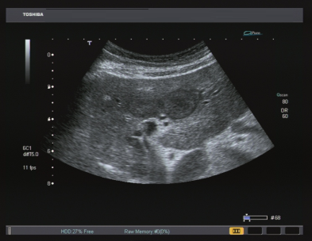
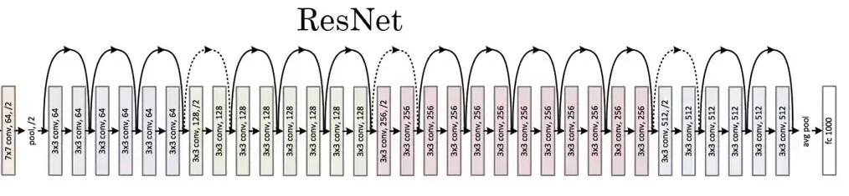
System Architecture
contrast-enhanced ultrasound Dataset
Pre-processing of Data
Benign
Trained Model
Test Input
Malignant

Slide 14
Modules
Data Collection
Pre-processing
Training
Testing

Slide 15
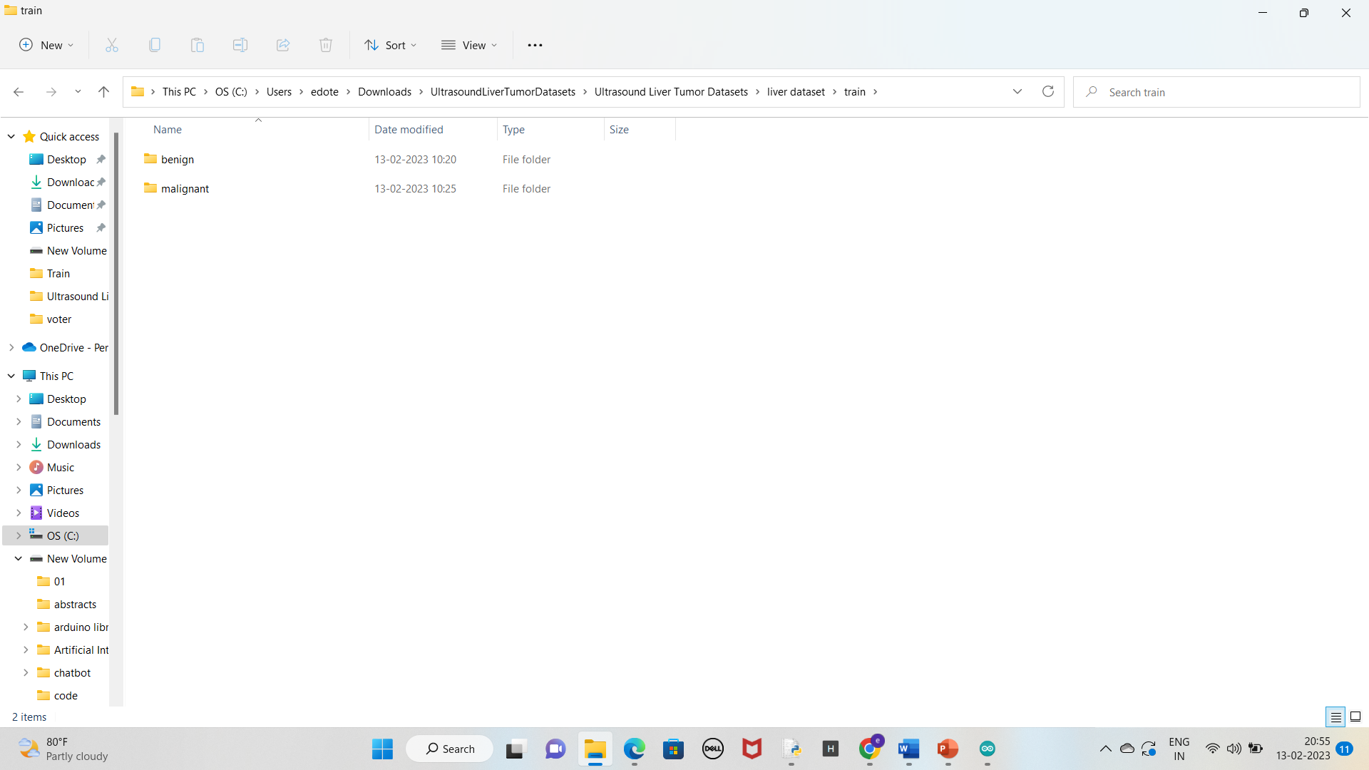
DATA COLLECTION
In our project we have totally 300 ultrasonic scan images, in that 300
250 images are used for Training purpose
50 images are used for Validation purpose.
In that 300 image file
150 images are Benign Image and
Remaining 150 images represents Malignant images (liver cancer)
MODULE 1

Slide 16
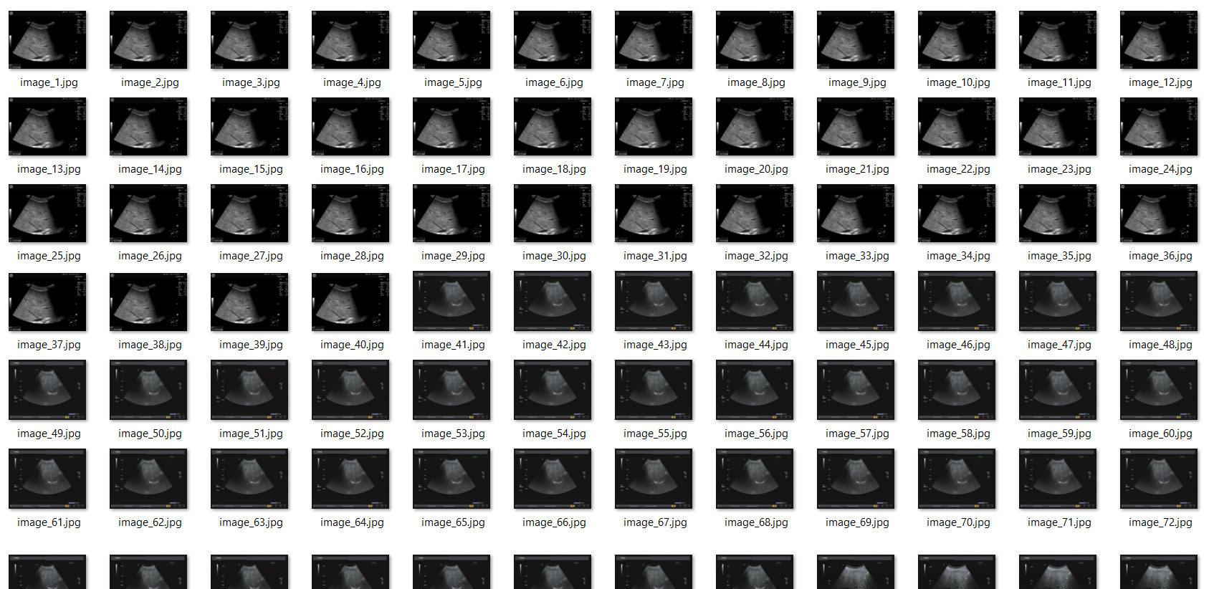
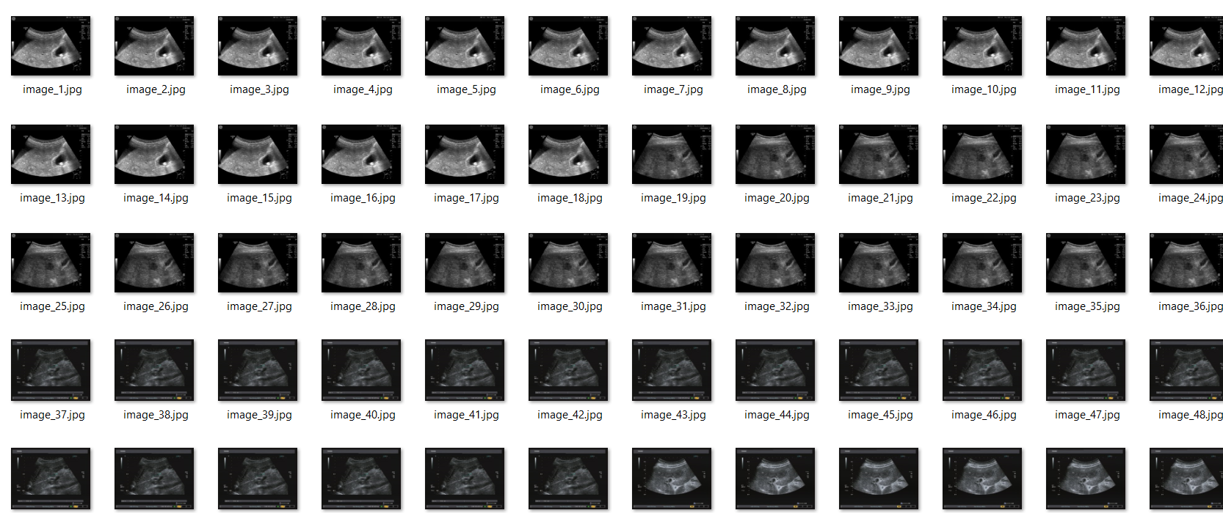
Liver Ultrasonic scan Images Benign
Liver Ultrasonic scan Images Malignant

Slide 17
PRE PROCESSING
At first these 300 images are pre-processed by using pre-processing techniques such as
A pre-processing or filtering step is applied to minimize the degradation related to the noise.
This stage is necessary to enhance the liver image quality and made the image component more reliable for the improvement of broad and narrow input image.
Thus after preprocessing the image became high quality images .
This pre processing is also done in Google colab.
MODULE 2
Zooming
shearing
rescaling
horizontal flipping

Slide 18
TRANING
MODULE 3
The pre-processed ultrasonic liver images are then fed into the Residual Neural Network architecture which is of 50 layers and it trains the data using its parameters to produce a trained model.
This model will then be capable of accurately analyzing the liver images and detecting any anomalies or abnormalities. The ResNet 50 architecture is designed to effectively capture the complex relationships and patterns within the pre-processed data, allowing for improved accuracy in the training process.
The end result is a highly effective and efficient model that can be used for accurate liver image analysis.
We have trained the model using the dataset in the Google Colab for faster training and accuracy.

Slide 19
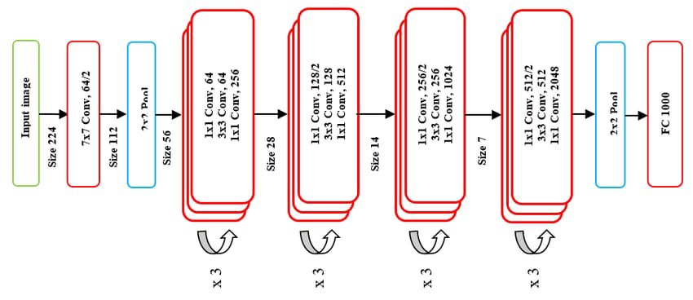
Resnet 50 Architecture

Slide 20
Resnet 50
ResNet 50 is a deep residual neural network architecture developed by Microsoft Research team.
It is a 50-layer convolutional neural network that utilizes residual connections to allow the network to learn features that are difficult to learn by traditional feedforward neural networks.
The architecture of ResNet 50 is composed of a stem, 4 residual blocks, and a head.
The stem is a 7x7 convolutional layer followed by a max-pooling layer and two 3x3 convolutional layers.
Each residual block is composed of three consecutive building blocks.

Slide 21
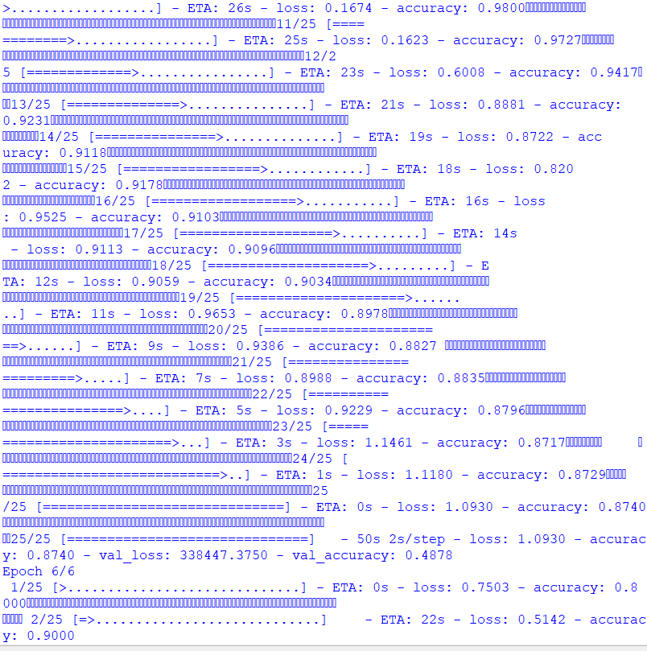
RESNET Training Process

Slide 22
TESTING
MODULE 4
During the testing phase, the ultrasonic liver image data is inputted into the previously trained model.
The training is given in the Google Colab and the testing is done in the “Python IDLE “.
The modules are imported in the Python IDLE
This allows the model to analyze the data and make predictions based on its training.
It gives high accuracy because the training is done by the error method.
The final outcome of this process is a determination of whether the liver condition is benign or malignant, specifically liver cancer.

Slide 23
Hardware Requirements A PC with windows OS Software Requirements
Python IDE 3.7.6
Software Packages
Numpy
Keras
Tensorflow

Slide 24


We have 2 kinds of Input datasets
Pre processed: Input Images Count

Slide 25


Liver Ultrasonic scan Images - Benign
Liver Ultrasonic scan Images - Malignant

Slide 26
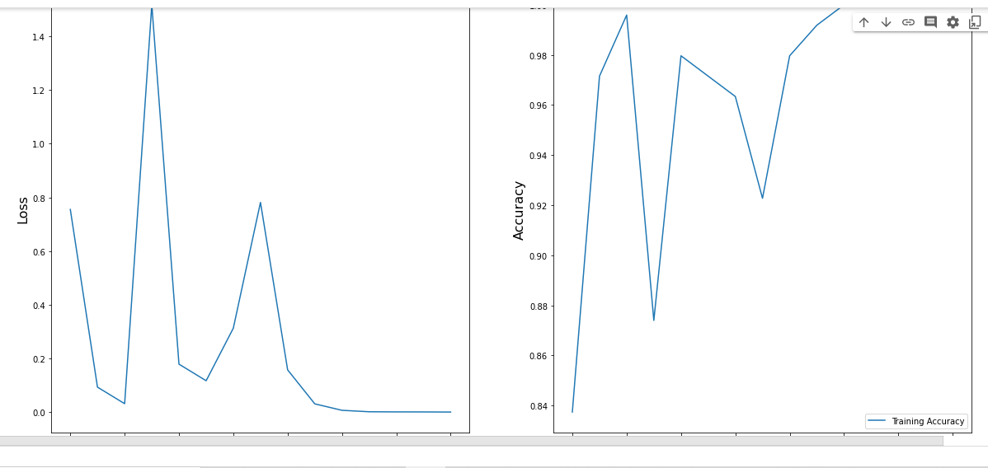
Initial Training Loss, Accuracy vs epoch graph

Slide 27
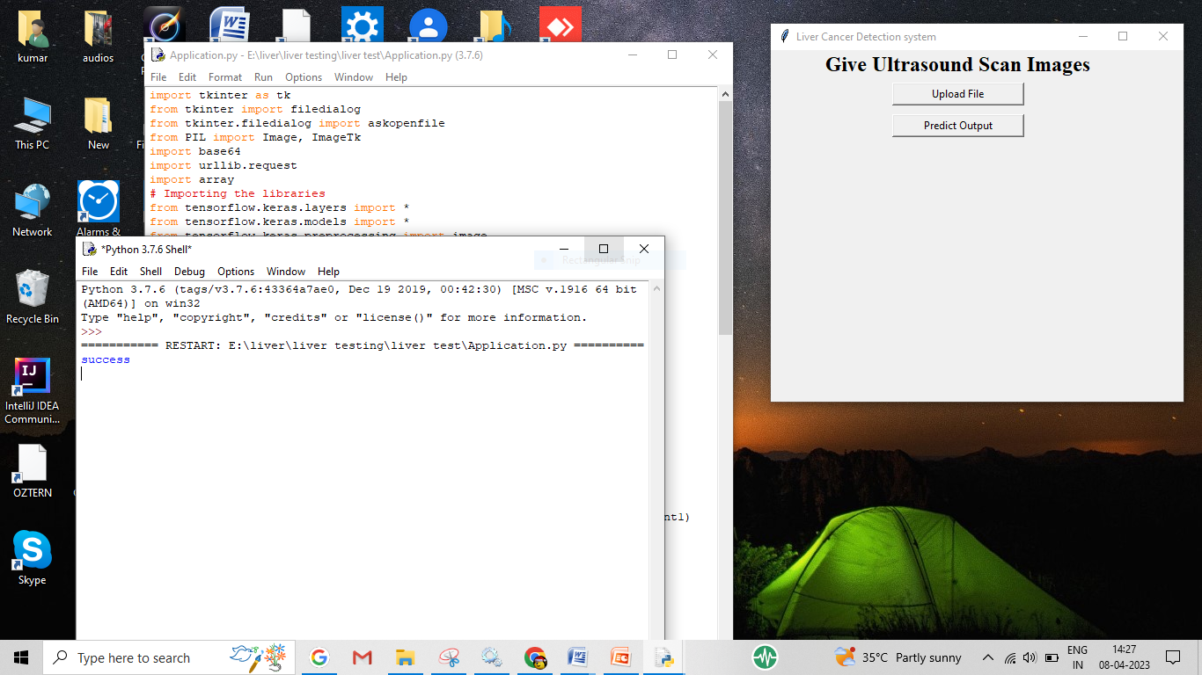
PYTHON SHELL FOR TESTING : We opened the file which is already trained. It gives the message as “ Success”

Slide 28
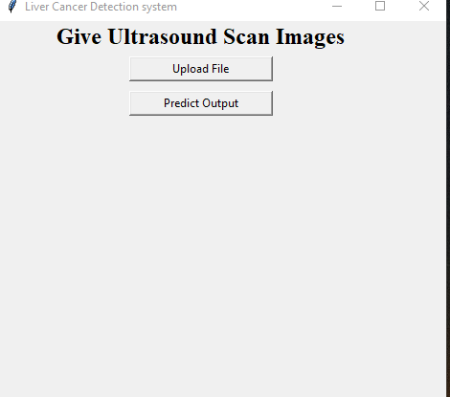
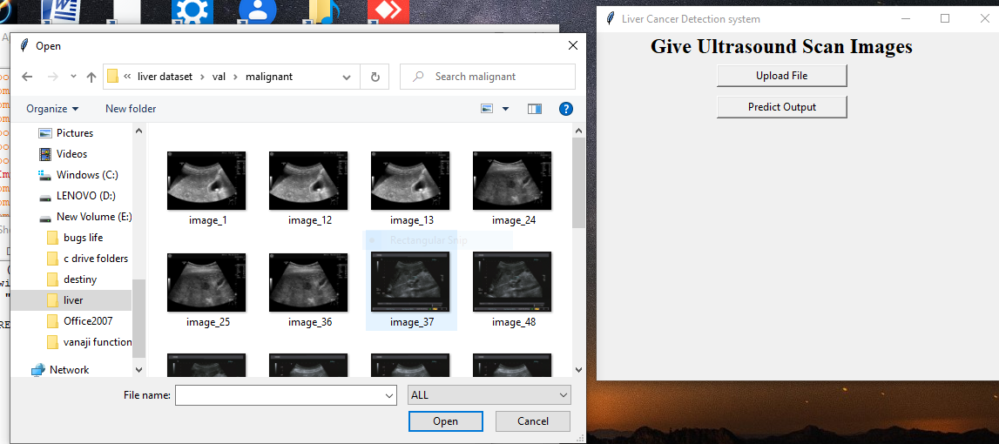
UPLOD AND PREDICT OUTPUT :

Slide 29
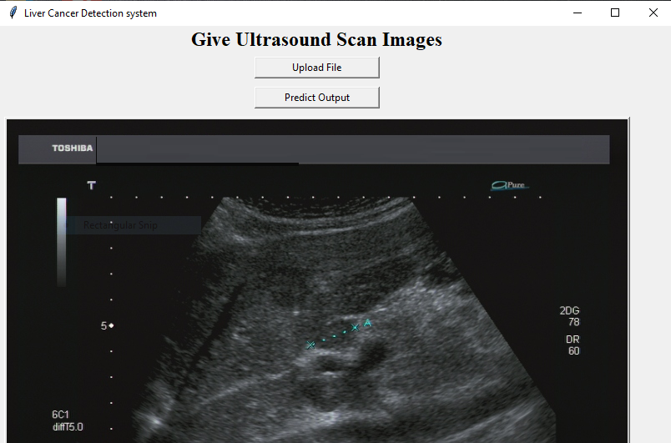
We have uploaded the Ultrasonic image and ask to predict the output whether it is benign or malignant
This predict output gives the result from the trained knowledge .
Now It does not refer the data set image it only refer the trained knowledge

Slide 30
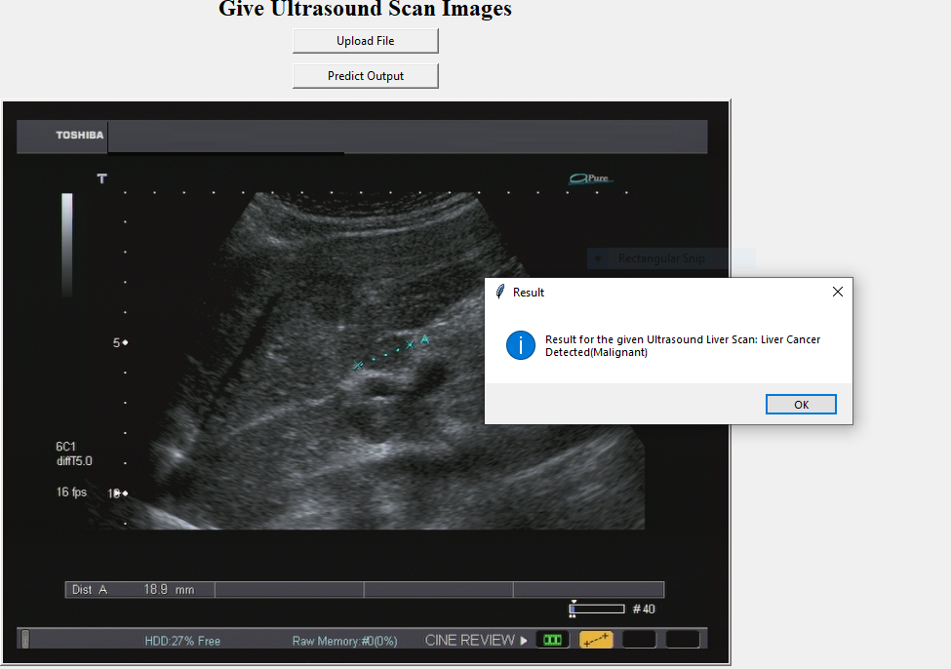
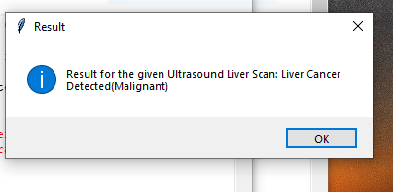
Result:
It predict the accurate result for the given Ultrasonic images,
The result displays in the dialogue box .
It gives efficient result as whether it is Benign or Malignant

Slide 31
CONCLUSION
In this paper, we presented an automated system for the detection of liver tumors (hepatocellular carcinoma) based on deep learning as well as transfer learning
. The analysis of the performance of the proposed system shows that the classification process produced an optimal accuracy of 90% with a negligible loss of validation.
This method is therefore an efficient way to detect the cancerous area from liver images that will be useful for clinical diagnosis and decision making for early diagnosis
.
Thus it greatly helps the patient for the Early diagnosis of cancer.
It paved a great way to avoid the crucial process as Biopsy .
Thus our system saves the life of many people

Slide 32
REFERENCE
[1] Guan Gui, Senior Member, IEEE, Fan Liu, Student Member, IEEE, Jinlong Sun, Member, IEEE, Jie Yang, Member, IEEE, Ziqi Zhou, Student Member, IEEE, and Dongxu Zhao, Student Member, IEEE “Flight Delay Prediction Based on Aviation Big Data and Machine Learning “in IEEE VOLUME: 69, JAN. 2020
[2] Yunpeng Jiang; Jiahe Miao; Xinyue Zhang; Ningning Le, “A multi-index prediction method for flight delay based on long short-term memory network model”, in IEEE VOLUME: 69, JAN. 2020
[3] Jiang Tao; Hua Man; Li Yanling, “Flight delay prediction based on LightGBM”, in IEEE VOLUME 69 2020.
[4] J. A. F. Zuluaga, J. F. V. Bonilla, J. D. O. Pabon, and C. M. S. Rios, “Radar error calculation and correction system based on ads-b and business intelligent tools,” in Proc. Int. Carnahan Conf. Secur. Technol., pp. 1–5, IEEE, 2018.
[5] D. A. Pamplona, L. Weigang, A. G. de Barros, E. H. Shiguemori, and C. J. P. Alves, “Supervised neural network with multilevel input layers for predicting of air traffic c delays,” in Proc. Int. Jt. Conf. Neural Networks, pp. 1–6, IEEE, 2018

Slide 33
[6]Ghassemi, P., Samaras, D., Kavantzas, N., Chatziioannou, A., & Kostopoulos, S. (2021). Deep learning for hepatocellular carcinoma detection and diagnosis: A systematic review. Computerized Medical Imaging and Graphics, 92, 101899.
[7]Kang, J., Shin, C. I., Han, Y. H., Ko, H. K., & Choi, J. W. (2020). Deep learning for automated segmentation and classification of liver masses on contrast-enhanced CT. European Radiology, 30(1), 244-253.
[8]Kim, K., Cho, K., Cho, K. H., Park, S., & Lee, H. (2019). Detection and classification of liver tumors in CT images using deep learning. Medical Physics, 46(1), 369-382.
[9]Lee, S., Nam, J. G., Cho, Y. W., Han, K., Park, J. H., & Kim, J. H. (2020). Development and validation of a deep learning system for staging liver fibrosis by using contrast agent-enhanced CT images in the liver. Radiology, 296(3), 555-565.
[10]Li, Z., Lei, X., Zhang, Q., Liang, J., Chen, S., Liang, C., ... & Li, M. (2021). Multi-modal imaging-based deep learning models for the preoperative diagnosis of liver cancer. IEEE Journal of Biomedical and Health Informatics, 25(5), 1715-1724.

Slide 34
[11]Liu, Y., Liu, W., Liao, M., Wang, K., & Tang, X. (2020). A hybrid deep learning framework for liver cancer classification. Frontiers in Bioengineering and Biotechnology, 8, 113.
[12]Ouyang, Y., Chen, X., Zhang, W., Ren, J., & Yu, S. (2020). Detection of liver metastases with a deep learning convolutional neural network trained on ultrasound imaging. Medical Science Monitor, 26, e920105-1.
[13]Wang, H., Wang, Z., Zhang, Y., & Qian, Y. (2021). Diagnosis of liver cancer by deep learning from CT images. Medical & Biological Engineering & Computing, 59(2), 399-412.
[14]Xu, Y., Lu, J., Wang, J., Zhang, Y., Huang, G., & Ma, K. (2020). Deep convolutional neural network for accurate diagnosis of liver cancer using ultrasound images. Computer Methods and Programs in Biomedicine, 187, 105236.

Slide 35
THANK YOU!

